Slide 1
TRAUMA AND HEALING
MEANINGFUL CHANGE

Slide 2
Acknowledgement of Elders Past, Present and future leaders and the Larrakia People, the Custodians of this Land we meet on.
I wish to pay respect to Aboriginal women who have lead the way, done the tough path and to my mother, grandmother and ancestors who dreamed me to being.

Slide 3
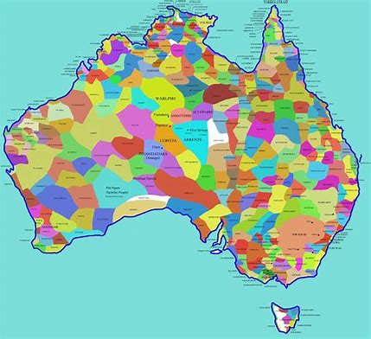

Slide 4
MEANINGFUL CHANGE
AN ABORIGINAL HUMANIST AND AGENT OF CHANGE PERSPECTIVE
I am going to have a yarn with you all about what I’ve learned as core principles of practice from my over 50 year life span as an Aboriginal person and my 30 year career as a social worker, an agent of change. The main principles of practice I will focus on are: courage, compassion, competent care and culturally safe practice.

Slide 5
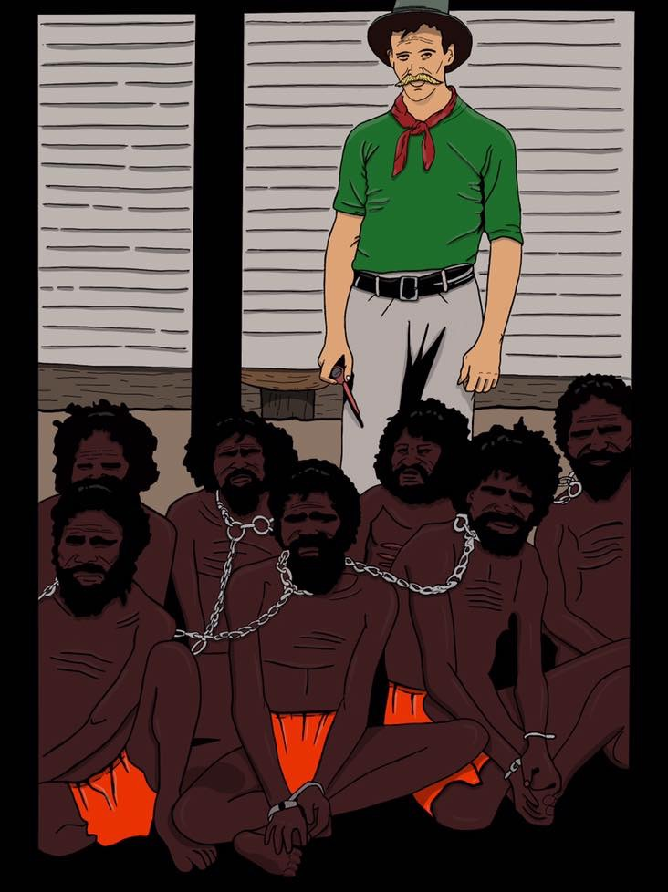
Artist: Jason Lee
Notes:
We must acknowledge the back drop to our story which is one of brutality, murder, rape, devaluation, dehumanisation, destruction and a legacy of intergenerational trauma, grief and loss, continued incarceration, and to be treated as less worthy.

Slide 6
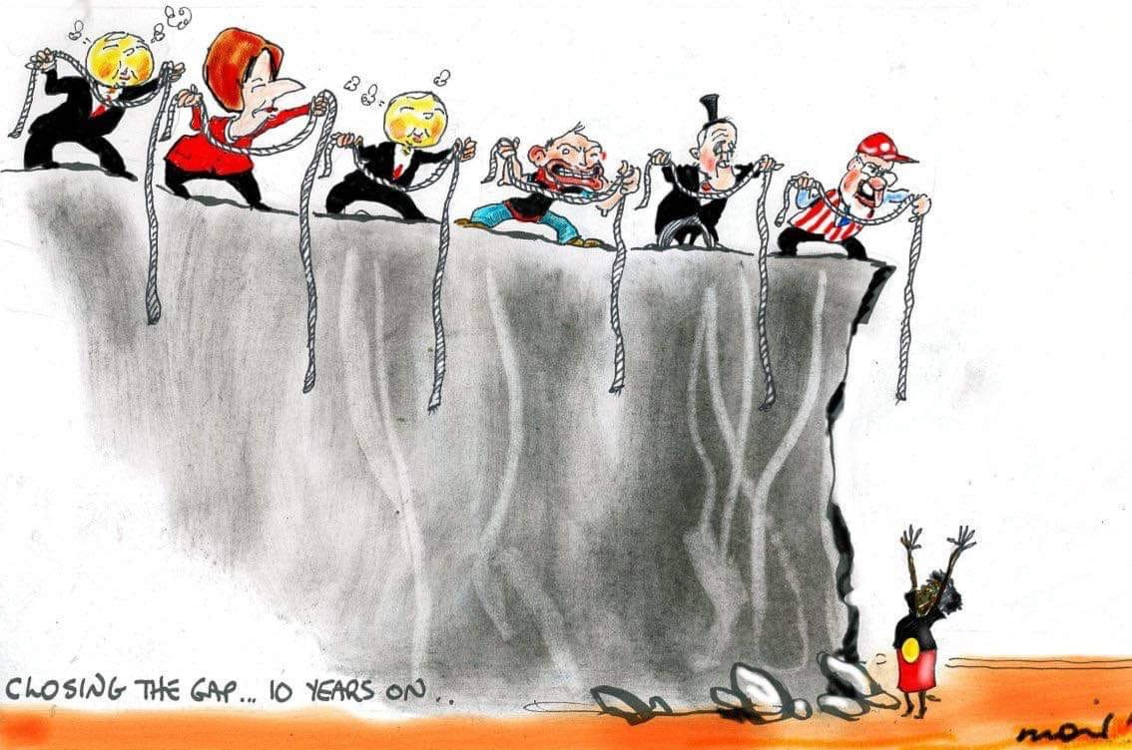

Slide 7
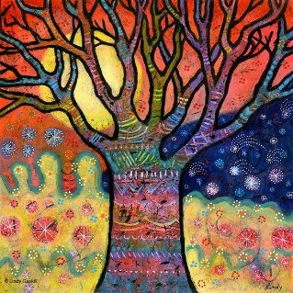
“As nations of Indigenous peoples throughout the world, we have faced a barrage of colonial oppressive acts that have impacted our nations, communities, families, and people. From the moment we are born to the moment we die, we live a political reality where acts of oppression are perpetrated against us daily in conscious and unconscious ways. These acts, from unconscious marginalization to purposefully imposed violence, are meant to remove our presence and have resulted in disconnections for many Indigenous peoples from our lands, waters, cultures, histories, knowledges, and dreams. These disconnections are evident in the negative statistics related to our health, socio-economic status, and psychological well-being. Worse yet are the deaths of our people throughout colonial oppression that is rarely recognized (Razack 2015). Despite these depressing factors, the real story for our people throughout the world is one of strength, effort, ability, knowledge, and inter-generational commitment.” (p. 1 Hart)
Notes:
“As nations of Indigenous peoples throughout the world, we have faced a barrage of colonial oppressive acts that have impacted our nations, communities, families and people. From the moment we are born to the moment we die, we live a political reality where acts of oppression are perpetrated against us daily in conscious and unconscious ways. These acts, from unconscious marginalization to purposefully imposed violence, are meant to remove our presence and have resulted in disconnections for many Indigenous peoples from our lands, waters, cultures, histories, knowledges, and dreams. These disconnections are evident in the negative statistics related to our health, socio-economic status, and psychological well-being. Worse yet are the deaths of our people throughout colonial oppression that is rarely recognized (Razack 2015). Despite these depressing factors, the real story for our people throughout the world is one of strength, effort, ability, knowledge, and intergenerational commitment.” (p.1 Hart)

Slide 8
CORE PRINCIPLES FOR PRACTICE TO ACHIEVE MEANINGFUL CHANGE
Courage
Compassion
Competent Care
Culturally Safe Practice
Notes:
The 4 Cs – Courage (to be brave and take action), Compassion (to understand and listen deeply), Competent Care (up for walking alongside, empowering and belief in others) and Culturally Safe Practice (Cultural Competence, to respect)

Slide 9
ABORIGINAL AND TORRES STRAIT ISLANDER KNOWLEDGE AND WISDOM
Terminology – Aboriginal and Torres Strait Islander (my preference)
Indigenous
First Nations
Decolonisation
Black Empowerment
Aboriginal ways of knowing, doing and being
Notes:
My preference is to use the terminology is Aboriginal and Aboriginal and Torres Strait Islander over Indigenous.
First Nations
Decolonisation
Black Empowerment
Aboriginal ways of knowing, doing and being

Slide 10
THEORIES AND APPROACHES
Relationship-based
Trauma-informed
Narrative Therapy
Strengths-based
Compassionate Inquiry
Impact on people’s lives in a positive way
To do no harm
Notes:
Theories and Approaches
Relationship-based
Trauma-informed
Narrative Therapy
Strengths-based
Compassionate Inquiry
Impact on people’s lives in a positive way
To do no harm

Slide 11
Backgrounds and Contexts
National Framework for Aboriginal and Torres Strait Islander Social and Emotional Wellbeing
Social Determinants
Indigenous Knowledges
International Social Work
Notes:
Backgrounds and contexts
National Framework for Aboriginal and Torres Strait Islander Social and Emotional Wellbeing
Social Determinants
Indigenous Knowledges
International Social Work

Slide 12
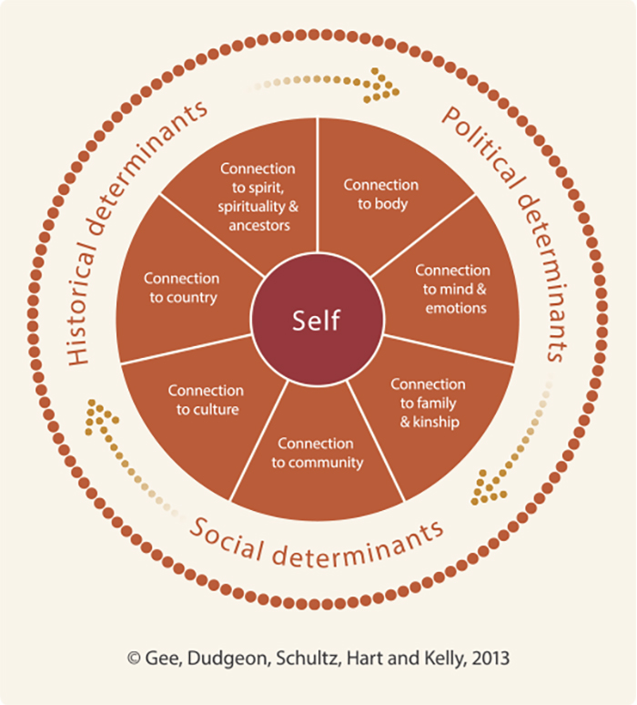
National Framework for Aboriginal and Torres Strait Islander Social and Emotional Wellbeing
Notes:
National Framework for Aboriginal and Torres Strait Islander Social and Emotional Wellbeing

Slide 13
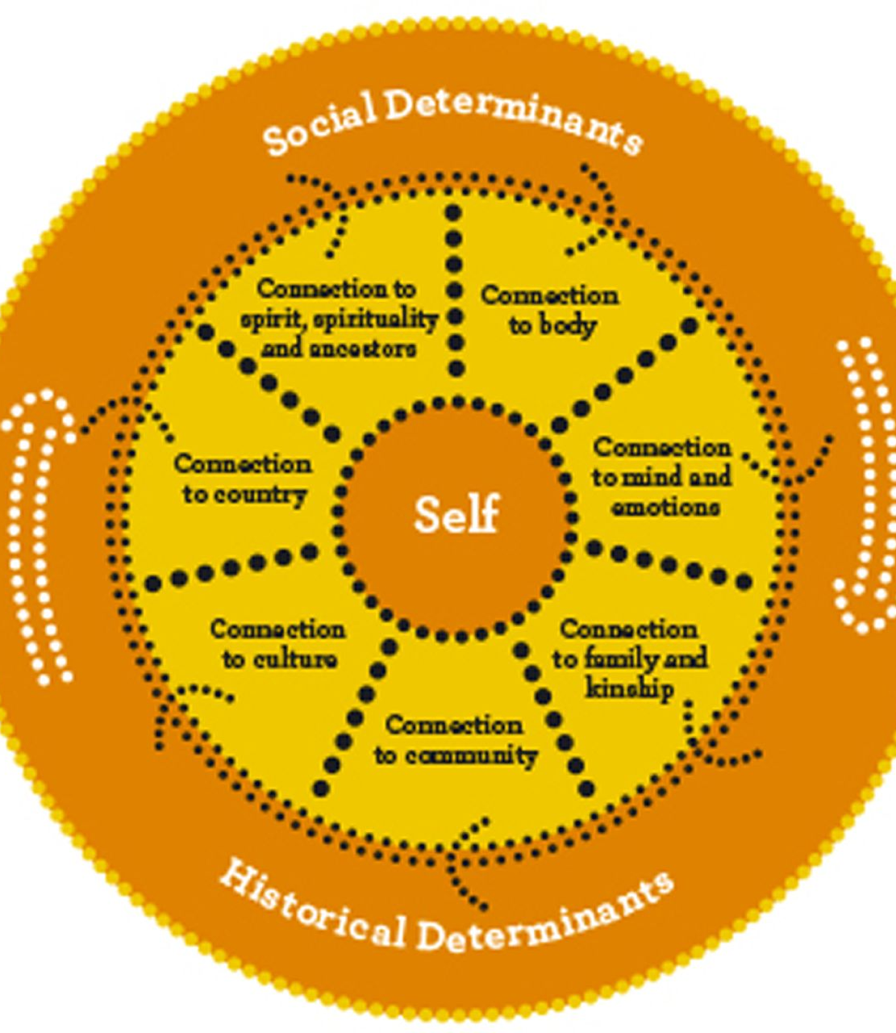
Connectedness -Individual, Collective, Culture, Community, Country, Caring for self, each other and Creation.
Notes:
Social Determinant’s and Historical Determinations
Connections
Connectedness -Individual, Collective, Culture, Community, Country, Caring for self, each other and Creation.

Slide 14
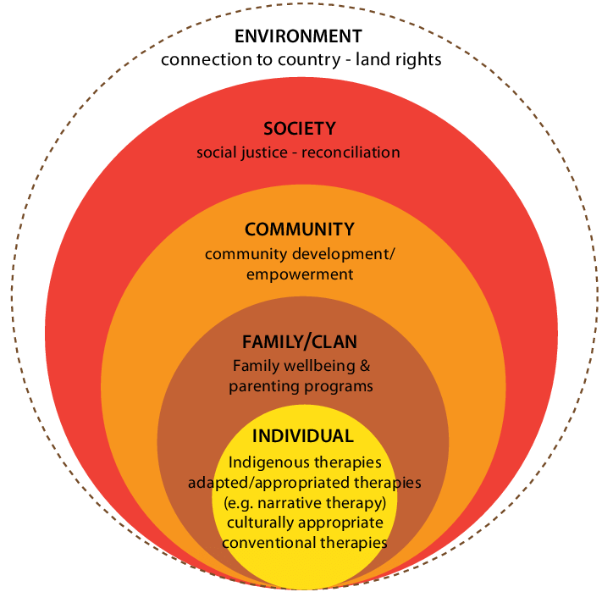
Prevention, early intervention, building on strengths, generational change, healing, reclaiming, recovery
Notes:
Prevention, early intervention, building on strengths, generational change, healing, reclaiming, recovery

Slide 15
SOCIAL WORK (International Federation of Social Workers)
Social work is a practice-based profession and an academic discipline that promotes social change and development, social cohesion, and the empowerment and liberation of people. Principles of social justice, human rights, collective responsibility and respect for diversities are central to social work. Underpinned by theories of social work, social sciences, humanities and Indigenous knowledge, social work engages people and structures to address life challenges and enhance well-being.
Notes:
Social work is a practice-based profession and an academic discipline that promotes social change and development, social cohesion, and the empowerment and liberation of people. Principles of social justice, human rights, collective responsibility and respect for diversities are central to social work. Underpinned by theories of social work, social sciences, humanities and Indigenous knowledge, social work engages people and structures to address life challenges and enhance well-being.

Slide 16
International Federation of Social Workers, have added:
Social work seeks to redress historic Western scientific colonialism and hegemony by listening to and learning from Indigenous people around the world. In this way social work knowledge will be co-created and informed by Indigenous people, and more appropriately practiced not only in local environments but also internationally.
Notes:
International Federation of Social Workers, have added:
Social Work seeks to redress historic Western scientific colonialism and hegemony by listening to and learning from Indigenous people around the world. In this way social work knowledge will be co-created and informed by Indigenous people, and more appropriately practiced not only in local environments but also internationally.

Slide 17
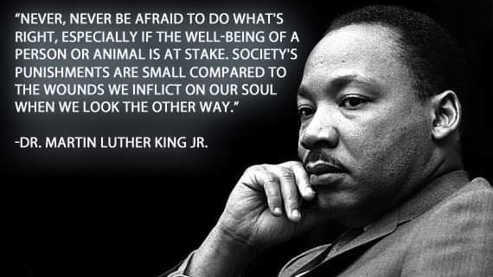
Notes:
“Never, never be afraid to do what’s right, especially if the well-being of a person or animal is at stake. Society’s punishments are small compared to the wounds we inflict on our soul when we look the other way.” Dr Martin Luther King Jr.

Slide 18
COURAGE
“Courage has a ripple effect. Every time we choose courage, we make everyone around us a little better and the world a little braver. And our world could stand to be a little kinder and braver.” (Brene Brown)
Notes:
“Courage has a ripple effect. Every time we choose courage, we make everyone around us a little better and the world a little braver. And our world could stand to be a little kinder and braver.”

Slide 19
COMPASSION
“Compassion is always, at its most authentic, about a shift from the cramped world of self-preoccupation into a more expansive place of fellowship, of true kinship.” (Boyle)
Notes:
“Compassion is always, at its most authentic, about a shift from the cramped world of self-preoccupation into a more expansive place of fellowship, of true kinship.” (Boyle)

Slide 20
“Author and psychiatrist James Gilligan writes that the self cannot survive without love, and the self, starved of love, dies. The absence of self-love is shame, “just as cold is the absence of warmth.” Disgrace obscuring the sun.
Guilt of course, is feeling bad about one’s actions, but shame is feeling bad about oneself. Failure, embarrassment, weakness, overwhelming worthlessness, and feeling disgracefully “less than” – all permeating the marrow of the soul.
Mother Teresa told a roomful of lepers once how loved by God they were and a “gift to the rest of us.” Interrupting her, an old leper raises his hand, and she calls on him. “Could you repeat that again? It did me good. So, would you mind…just saying it again.”” (p.46 Boyle)
Notes:
“Author and psychiatrist James Gilligan writes that the self cannot survive without love, and the self, starved of love, dies. The absence of self-love is shame, “just as cold is the absence of warmth.” Disgrace obscuring the sun.
Guilt of course, is feeling bad about one’s actions, but shame is feeling bad about oneself. Failure, embarrassment, weakness, overwhelming worthlessness, and feeling disgracefully “less than” – all permeating the marrow of the soul.
Mother Teresa told a roomful of lepers once how loved by God they were and a “gift to the rest of us.” Interrupting her, an old leper raises his hand, and she calls on him. “Could you repeat that again? It did me good. So, would you mind…just saying it again.”” (p.46 Boyle)

Slide 21
COMPETENT CARE
Capable and responsive
Moving beyond borders
Courageous conversations
We are all equal
Shared power/handover
Do not enter into demonization or othering discourses
Notes:
Competent Care

Slide 22
CULTURALLY SAFE PRACTICE
Notes:
Cultural Safety
It is a term used to describe a way of working with people of different cultural backgrounds that does not diminish, demean or disempower someone.
A person should feel safe to talk about their own unique world views and cultural values without feeling less important than other. Cultural safety is a way of working rather than specific knowledge about cultures.

Slide 23
RELATIONSHIP BASED
“Relationships matters critically. Consistent relationships with caring adults are essential for healthy development.
All learning takes place in the context of relationships and is critically affected by the quality of those relationships.
…adults who are most consistently available and committed to the child’s wellbeing play a special role in promoting competence and adaptation that cannot be replaced by individuals who are present less consistently or whose emotional commitment is not unconditional.” (Larry Edelmen)
Notes:
“Relationships matters critically. Consistent relationships with caring adults are essential for healthy development.
All learning takes place in the context of relationships and is critically affected by the quality of those relationships.
…adults who are most consistently available and committed to the child’s wellbeing play a special role in promoting competence and adaptation that cannot be replaced by individuals who are present less consistently or whose emotional commitment is not unconditional.” (Larry Edelmen)
Brian Cade, Family Therapist. Relationship-based work – honourable behaviours

Slide 24
TRAUMA-INFORMED
Dr Bessell Van der Kolk The Body Keeps Score
- Recovery
- Healing
- Neurobiology, neuroscience,
- Rewired to feel threat everywhere
- Secrecy, shame and courageous conversations
- To really move on
- Be in relation with, use energetic power, regulation of the breath,
Notes:
Dr Bessell Van der Kolk The Body Keeps Score
- Recovery
- Healing
- Neurobiology, neuroscience,
- Rewired to feel threat everywhere
- Secrecy, shame and courageous conversations
- To really move on
- Be in relation with, use energetic power, regulation of the breath,

Slide 25
NARRATIVE THERAPY
Narrative therapy is a form of therapy that aims to separate the individual from the problem, allowing the individual to externalize their issues rather than internalize them. It relies on the individual’s own skills and sense of purpose to guide them through difficult times.
Narrative Therapy is respectful.
Narrative Therapy is non-blaming.
Narrative Therapy view the client as expert.
Notes:
Narrative therapy is a form of therapy that aims to separate the individual from the problem, allowing the individual to externalize their issues rather than internalize them. It relies on the individual’s own skills and sense of purpose to guide them through difficult times.
Narrative Therapy is respectful.
Narrative Therapy is non-blaming.
Narrative Therapy view the client as expert.

Slide 26
STRENGTHS-BASED
Practice of Respect
Bring hope and find solutions
Work with people and communities strengths
Inclusion, collaboration, transparency, respect, sharing of power and resources, and regard for human rights
Right to self-determination
Human dignity and potential
Notes:
Practice of Respect
Bring hope and find solutions
Work with people and communities strengths
Inclusion, collaboration, transparency, respect, sharing of power and resources, and regard for human rights
Right to self-determination
Human dignity and potential

Slide 27
COMPASSIONATE INQUIRY
What is compassionate inquiry?
Compassionate inquiry is a psychotherapeutic approach developed by Dr Gabor Mate that reveals what lies beneath the appearance to the world.
How to talk with people, especially to listen to people.
Asking the right question at the right time.
Relationship is therapy.
Inside all of us is the capacity for healing.
Healing force that attempts to heal – inside all of us.
The degree of safety experienced. How well-connected they feel.
Unconditional determination to understand the person.
In order for the person to understand themselves.
Notes:
What is compassionate inquiry?
Compassionate inquiry is a psychotherapeutic approach developed by Dr Gabor Mate that reveals what lies beneath the appearance to the world.
How to talk with people, especially to listen to people.
Asking the right question at the right time.
Relationship is therapy.
Inside all of us is the capacity for healing.
Healing force that attempts to heal – inside all of us.
The degree of safety experienced. How well-connected they feel.
Unconditional determination to understand the person.
In order for the person to understand themselves.
What is compassionate inquiry?
Compassionate inquiry is a psychotherapeutic approach developed by Dr Gabor Mate that reveals what lies beneath the appearance to the world.
How to talk with people, especially to listen to people.
Asking the right question at the right time.
Relationship is therapy.
Inside all of us is the capacity for healing.
Healing force that attempts to heal – inside all of us.
The degree of safety experienced. How well-connected they feel.
Unconditional determination to understand the person.
In order for the person to understand themselves.
Presence without judgment, with the intention of healing
Aid healing
Make better at feeling, dealing with whatever is there, not afraid of the pain, when facing the truth,
Clear mirror, going to see the pain,
Dealt with own pain
Allow the truth of the pain to guide a person’s path
Being present with people and their pain

Slide 28
POSITIVE IMPACT
“We must use time wisely and forever realize that the time is always ripe to do what is right.” Nelson Mandela
Notes:
But I have found in the simple act of living with hope, and in the daily effort of to have a positive impact in the world, the days I do have are made all the more meaningful and precious. And for that I am grateful.

Slide 29
DO NO HARM
Give thoughtful consideration to our actions and the impact on others and communities

Slide 30
HOPE DEALERS

Slide 31
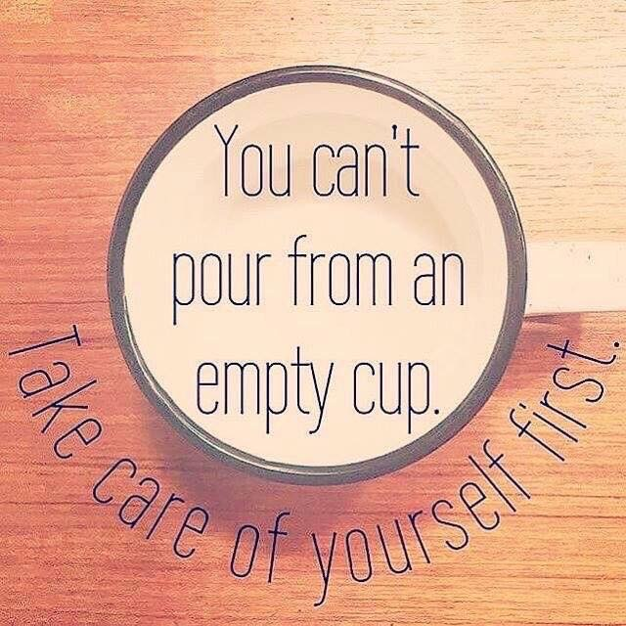

Slide 32
“Each person deserves a day away in which no problems are confronted, no solutions searched for.
Each of us needs to withdraw from the cares which will not withdraw from us.” Maya Angelou
SELF-CARE
Notes:
“Each person deserves a day away in which no problems are confronted, no solutions searched for.
Each of us needs to withdraw from the cares which will not withdraw from us.”
Maya Angelou

Slide 33
REFERENCES
Angelou, Maya. An American Poet, singer, memorist, and civil rights activist.
Boyle, Gregory (2010) Tattoos on the Heart: The Power of Boundless Compassion Freepress, New York, USA.
Brown, Brene (2010) The Gifts of Imperfection: Let Go of Who You Think You’re Supposed to Be and Embrace Who You Are Hazelden Publishing, USA.
Dr Martin Luther-King Junior
Dr Bessell Van der Kolk The Body Keeps Score
Edelman, Larry (2004) Relationship-based to Early Intervention
Google search
Hart, Michael Anthony and Burton, Amanda Dawne (2016) International Indigenous Voices in Social Work Cambridge Scholars Publishing, UK.
Healing Our Spirit Worldwide Conference 2018, Sydney.
Lee, Jason. Artist
Life opportunities. Life challenges. Life lessons.
Mate, Gabor Compassionate Inquiry
McCashen, Wayne Strengths-based Approach
National Aboriginal and Torres Strait Islander Social and Emotional Wellbeing Framework
White, Michael and Epstein, David Narrative Therapy

