Slide 1



Welcome to our home
SAMPLE IMAGE
right click to replace
My/our names are:
[insert name/s]
Include a picture of your family/yourself or your home above

Slide 2

About us
In this box, include a short blurb about each of the caregivers: name, occupation, interests, how long they have been caregivers for (if applicable).
Culture: What is the culture of the home? And how does this play a role in the way the family lives?
Include the caregivers feelings about the new placement. “We can’t wait to meet you and are happy to have you in our family.”
Include a picture of yourself in the box to the right
SAMPLE IMAGE
right click to replace

Slide 3

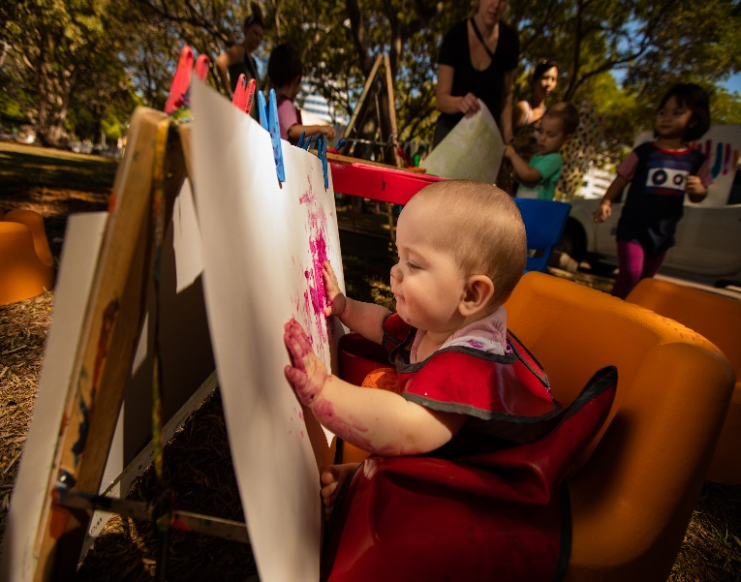
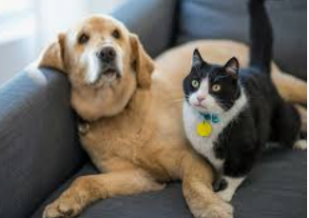
Who lives with us
SAMPLE IMAGE
right click to replace
For each other person living in the home (besides the caregivers), include:
  First name
  Age & gender
  their relationship to the caregiver
  Their interests, sports, hobbies (optional)
Include information about your pets.
In the boxes to the right, insert a photo of each person living in the home.
Name of the people in the box to the left
SAMPLE IMAGE
right click to replace
Name of the people or pets the box to the right

Slide 4
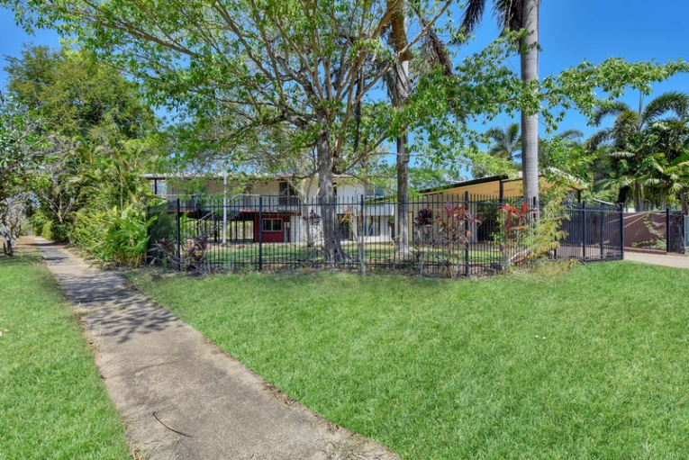
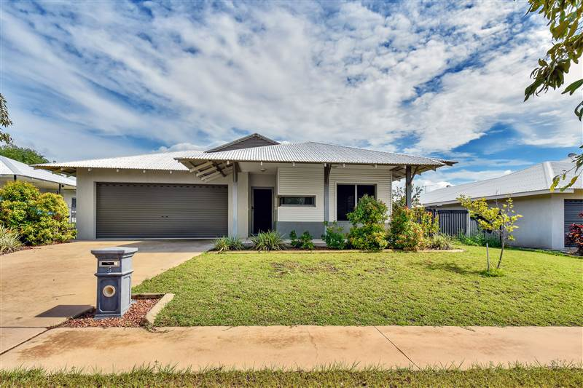
Where we live
SAMPLE IMAGE
right click to replace
In this box describe the area (urban/rural/near the sea/schools etc) you live.
Describe your house and garden.
In the boxes to your right include pictures of your house, neighbourhood, and/or yard.
Information on the neighbourhood i.e. there is a park across the road with a slide, pool, library, river, etc)
SAMPLE IMAGE
right click to replace

Slide 5
Our family life
Family activities/routines
How we do things
What do you do on a typical day or weekend?
What does your family do together for fun?
What daily routines does your family have e.g getting ready in the morning, we leave a light on in the hallway each night, mealtimes etc.
For teens, include curfews, and household expectations.
E.g we get our chores finished before any screen time is allowed.
In my/our home we like children/young people to ….. e.g. tell us/me if they are worried about something; always let us know where they are going etc)

Slide 6
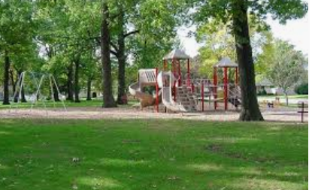


Things to do for fun
Include in this section what the family likes to do for fun, or what activities there are to do in the house or in the neighbourhood.
In the below boxes, include photos of the fun things mentioned, e.g. nearby park, toys, garden or any other relevant photos.
SAMPLE IMAGE
right click to replace

